Slide 1
Capstone Discussion
Template for 1st meeting
ÇAĞLA AKIN
⚠️*Note: You would need to be logged in a gmail account otherwise download the slide and upload it in google drive and share. Please give edit access

Slide 2
Problem Overview
🎯 The identified/potential problem statement?
For this project I’m using the Spotify song popularity case study (link). The relevant business question is:
“What makes a song popular? Can we identify the audio features that drive track popularity, and build a regression model to predict a song’s popularity score and help music labels and streaming platforms make data-driven decisions about the music they invest in?”
🔍 Why is it important to solve?
Spotify's largest cost driver is the royalties paid to artists, calculated based on each song's share of the total streaming pool. This means a more popular song gets a higher royalty payment. Since these agreements are negotiated with labels and artists beforehand, overpayment is a significant risk for Spotify. A predictive model can help estimate a song's popularity and support more data-driven decisions.

Slide 3
Data Overview
📊 Have you identified/sourced the required dataset?
I will use the dataset provided in the case study.

Slide 4
Data Overview
📊 Have you identified/sourced the required dataset? Spotify Tracks Data
Description | Spotify songs with artist names, song IDs, track names, popularity scores, release dates, release years, and audio features including danceability, energy, valence, tempo, loudness, acousticness, speechiness, instrumentalness, liveness, key, mode, duration_ms, and explicit flag.
Source | GitHub — Course Case Study (spotify_data.zip)
📏How many rows/columns? | ~170,000 rows, 19 columns
🔢 How many numerical/categorical columns? | Numerical (13) , Categorical(6)
🎯 Which is the target column? | popularity
🤔What kind of ML problem? | regression

Slide 5
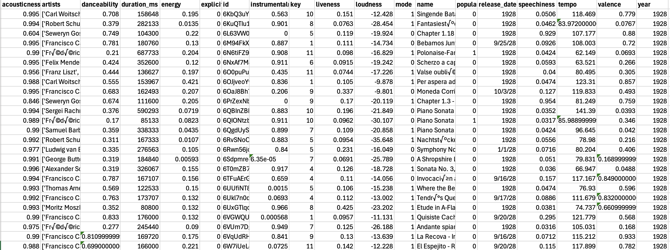
📊Can you share a sample of data in Google Sheet [sheet.new] (15 - 20 rows)?
Google Sheets Link

Slide 6
Data Overview - Dataset 1: Spotify Tracks Dataset
📙 Can you please add data dictionary (explanation of columns)?
id: Unique song ID
artists: Name of the artist(s) who performed the track
release_date: When the song was released (date format)
name: Name of the song
popularity: The popularity of a track is a value between 0 and 100, with 100 being the most popular. The popularity is calculated by algorithm and is based, in the most part, on the total number of plays the track has had and how recent those plays are.
duration_ms: The track length in milliseconds
explicit: Whether or not the track has explicit lyrics (true = yes it does; false = no it does not OR unknown)
danceability: Danceability describes how suitable a track is for dancing based on a combination of musical elements including tempo, rhythm stability, beat strength, and overall regularity. A value of 0.0 is least danceable and 1.0 is most danceable
energy: Energy is a measure from 0.0 to 1.0 and represents a perceptual measure of intensity and activity. Typically, energetic tracks feel fast, loud, and noisy. For example, death metal has high energy, while a Bach prelude scores low on the scale
key: The key the track is in. Integers map to pitches using standard Pitch Class notation. E.g. 0 = C, 1 = C♯/D♭, 2 = D, and so on. If no key was detected, the value is -1
loudness: The overall loudness of a track in decibels (dB)
mode: Mode indicates the modality (major or minor) of a track, the type of scale from which its melodic content is derived. Major is represented by 1 and minor is 0

Slide 7
Data Overview - Dataset 1: Spotify Tracks Dataset
📙 Can you please add data dictionary (explanation of columns)?
speechiness: Speechiness detects the presence of spoken words in a track. The more exclusively speech-like the recording (e.g. talk show, audio book, poetry), the closer to 1.0 the attribute value. Values above 0.66 describe tracks that are probably made entirely of spoken words. Values between 0.33 and 0.66 describe tracks that may contain both music and speech, either in sections or layered, including such cases as rap music. Values below 0.33 most likely represent music and other non-speech-like tracks
acousticness: A confidence measure from 0.0 to 1.0 of whether the track is acoustic. 1.0 represents high confidence the track is acoustic
instrumentalness: Predicts whether a track contains no vocals. "Ooh" and "aah" sounds are treated as instrumental in this context. Rap or spoken word tracks are clearly "vocal". The closer the instrumentalness value is to 1.0, the greater likelihood the track contains no vocal content
liveness: Detects the presence of an audience in the recording. Higher liveness values represent an increased probability that the track was performed live. A value above 0.8 provides strong likelihood that the track is live
valence: A measure from 0.0 to 1.0 describing the musical positiveness conveyed by a track. Tracks with high valence sound more positive (e.g. happy, cheerful, euphoric), while tracks with low valence sound more negative (e.g. sad, depressed, angry)
tempo: The overall estimated tempo of a track in beats per minute (BPM). In musical terminology, tempo is the speed or pace of a given piece and derives directly from the average beat duration
year: The release year of the song (numeric). Used as a temporal control variable in the regression model.

Slide 8
Methodological Overview
🛠️ Have you considered any techniques, pre-processing etc., that you will use?
EDA: Numerical and graphical summaries to identify which audio features are most associated with popularity.
Modelling: Linear Regression on numeric features only; 80/20 train-test split; evaluate using R² and RMSE on both train and test sets; plot actual vs. predicted values; attempt to improve accuracy by standardising features (StandardScaler).
⏳ Do you expect it to get solved within the time frame of the course?
Yes.
💡 What potential challenges do you expect?
Audio features alone may not fully explain popularity. External factors like marketing, playlist placement, and social media virality are not captured in the data. The linear regression baseline may have limited predictive power given the complexity of music trends. Overfitting is a risk if the dataset is not split carefully, so train vs. test performance will need to be monitored. Popularity scores can drift over time as older tracks lose streams, so the model reflects a snapshot rather than a timeless truth.

Slide 9
Methodological Overview
💬 What is the main thing you would like to discuss in the 1-1?
Whether the conclusions driven from the project are sufficient for the capstone requirements.

